Slide 1
B.TECH CSE with Specialization in DevOps
Advanced Linux
Delving Deep into Filesystem Hierarchy
Notes:
Notes to the Facilitator:
Introduce the module to the participants and tell them that you will be talking about Linux Filesystem Hierarchy, structure of Linux file system hierarchy, overview of top level directories, essential commands in /bin and /sbin, permissions in Linux and GRUB and MBR.
Notes to the Participants:
You will be discussing about Linux filesystem hierarchy, structure of Linux file system hierarchy, overview of top level directories, essential commands in /bin and /sbin, permissions in Linux and GRUB and MBR.

Slide 2
Module Objectives
At the end of this module, you will be able to:
Define Linux file system hierarchy
Explain the structure of Linux file system hierarchy
Provide an overview of top level directories
Discuss the essential commands in /bin and /sbin
Understand about permissions in Linux
Describe about GRUB and MBR
Notes:
Notes to the Facilitator:
Explain the module objectives to the participants.
Notes to the Participants:
You will be informed about the module objectives.
At the end of this module, you will be able to:
Define Linux file system hierarchy
Explain the structure of Linux file system hierarchy
Provide an overview of top level directories
Discuss the essential commands in /bin and /sbin
Understand about permissions in Linux
Describe about GRUB and MBR

Slide 3
Module Topics
Let us take a quick look at the topics that we will cover in this module:
Linux Filesystem Hierarchy
Structure of Linux Filesystem Hierarchy
Overview of Top Level Directories
Essential Commands in /bin and /sbin
Permissions in Linux
GRUB and MBR
Notes:
Notes to the Facilitator:
Inform the participants about the topics that they will be learning in this module.
Notes to the Participants:
You will learn about the following topics in this module:
Linux Filesystem Hierarchy
Structure of Linux Filesystem Hierarchy
Overview of Top Level Directories
Essential Commands in /bin and /sbin
Permissions in Linux
GRUB and MBR

Slide 4
1.1 Linux File System Hierarchy
Following are the key details of the Linux file system hierarchy:
File system defines the way the data is stored and retrieved from the medium.
It can be Solid state drive, hard disk and even a RAM.
It’s a software implementation which defines where and how the data bits are stored and retrieved.
File system includes various features which can enhance performance, functionality and reliability.
Notes:
Notes to the Facilitator:
Give an introduction about Linux file system hierarchy
Notes to the Participants:
In Linux most important file systems are as follows:
ext4
XFS
Btrfs
Ext4 is the most commonly used file system in Linux. ext4 is the fourth iteration in the ext (extended file system) series of Linux file systems. It’s released in 2008 and considered very stable, but it is not state-of-the-art: reliability is the most important consideration.
XFS is mostly used RHEL, Fedora and CentOS distributions (Red Hat Enterprise Linux, CentOS, Fedora). XFS file system contains some advanced features than ext4, such as larger file support, parallel I/O and better handling of large files.
Btrfs was designed by Oracle and was considered stable as on till 2014. Btrfs was preferable over ext4 and XFS because of its advanced features; the principal developer of ext4 even stated that ext4 should eventually be replaced by Btrfs. Btrfs uses the copy-on-write (COW) principle: files that are copied are actually not written to the disk fully, but a new pointer is created with the same data. The pointer will get updated only if new data is written.

Slide 5
1.2 Structure of Linux File System
Following are the key details of the structure of the Linux file system:
Linux and other Unix like systems use tree structure.
It is referred to as a tree because it starts at a single origin point, the root (found at /).
Directories are nested from there (like branches from a tree), not much different from other operating systems.
Finally, the tree structure ends in files which are considered the leaves of the tree.
Notes:
Notes to the Facilitator:
Explain about Linux file system structure.
Notes to the Participants:
When logging in to the system, by default, you will login to the home directory of the user. You can always find out the working directory by typing the pwd command
user@ubuntu:~$ pwd
/home/user
This is the default for most Linux distributions: /home/$USERNAME
To list the contents of the current directory, we use the ls command:
user@ubuntu:/$ ls bin dev home initrd.img.old lib64 media opt root sbin srv sys usr vmlinuz boot etc initrd.img lib lost+found mnt proc run snap swap.img tmp var vmlinuz.old
If you're using SSH, files and directories are differentiated using colors (and even directories or permissions, if you see tmp in a different manner; Run ls command:
user@ubuntu:/$ ls -l
total 2017372
drwxr-xr-x 2 root root 4096 10:31 bin
drwxr-xr-x 3 root root 4096 10:32 boot
drwxr-xr-x 19 root root 390010:31 dev
drwxr-xr-x 90 root root 409610:32 etc
drwxr-xr-x 3 root root 4096 18:20 home
lrwxrwxrwx 1 root root 33 11:39 initrd.img -> boot/initrd.img-4.15.0-29-generic
lrwxrwxrwx 1 root root 33 11:39 initrd.img.old -> boot/initrd.img-4.15.0-23-generic

Slide 6
1.3 Why a Linux File System is Unique?
Why a Linux File System is Unique?
Linux File system is adhered to the FHS (Filesystem Hierarchy Standard)
FHS is maintained by Linux foundation. The current version is 3.0
It is based on a Unix File system Standard or the UFS.
Notes:
Notes to the Facilitator:
Give an introduction about Linux File system hierarchy.
Notes to the Participants:
Linux File system adheres to FHS.
Linux file system is different when compared to Windows file system. In Linux any drive letters or backslashes are not present, but you can fine layout where different files can have the same name, but deferring with a capitalization in the name.
You can’t find any Program Files, Windows, or Users folders if you start browsing around the file system on your Linux computer.

Slide 7


1.3 Why a Linux file system is unique (Contd.)
The figure shows how image files are written to the disk.
Files “punch out” after work is done
Journal
Files “punch in” for disk write
Files do their work
Notes:
Notes to the Facilitator:
Explain why Linux File system is unique.
Notes to the Participants:
In the above image files are written to disk in three steps:
File system requests disk, writes from the journal
Journal writes on disk
After file write, journal is updated
If the server crashes between step 2 and 3, the write will continue again after power up, because the journal still has the entry. The journal contains metadata about the operation, but not the entire file. Since, the journal contains a reference to the drive sectors (actual location on disk), it will overwrite that was previously written, in this case part of the file. If it finishes successfully this time, the journal entry will be removed and the state of the file/disk is guaranteed. If the server fails between step 1 and 2, the actual instruction has never been given to write to disk.

Slide 8
1.4 Everything is a File
In Linux everything is considered as a file
If it is not a file, then it would be a process
Linux has 7 different types of files
Every ‘file’ has an owner and permissions
Classic Unix tools like cat, ls, ps, ... can query all the ‘files’
Notes:
Notes to the Facilitator:
Explain about file and different types of files in Linux.
Notes to the Participants:
The 7 types of files are as follows, denoted by the character used by Linux to represent them:
-: Normal file- A regular file, containing text or bytes
d: Directory - A directory, which can contain other directories and regular files
l: Symlink - Symbolic link, used as a shortcut
s: Socket - channel used for communication
c: Special file - Mostly used for device handlers
b: Block device - the type that represents storage hardware, such as disk partitions
p: Named pipe - Used between processes to talk to each other
Out of these 7 file types, you will first encounter just the regular files (-) and the directories (d). Next, you will probably interact some more with symlinks (l), block devices (b) and special files (c). Very rarely will you use the last two: sockets (s) and named pipes (p).

Slide 9
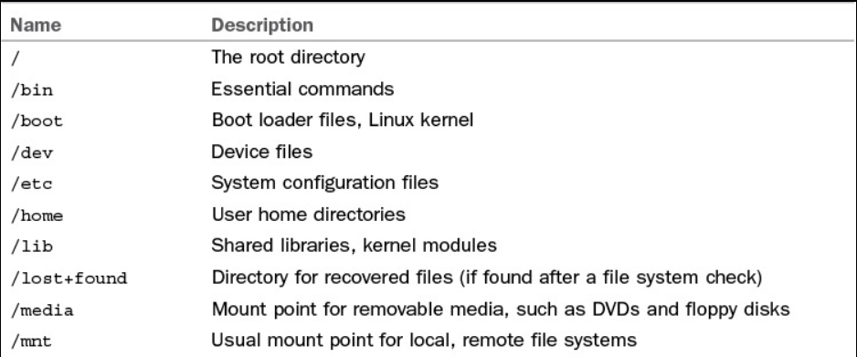
1.5 An Overview of Top Level Directories
The table summarizes the top level hierarchies in Linux.
Name Description
Notes:
Notes to the Facilitator:
Explain about different directories in Linux.
Notes to the Participants:
/root/ - The home directory of the root user
/bin/ - Contains essential binaries (=tools) used by normal users
/boot/ - Contains files used in the boot process: kernel, initramfs, bootloader
/dev/ - Contains special files used to access devices
/etc/ - Default location for software configuration files
/home/ - Contains the home directories for normal users
/lib/ - Contains system libraries
/lost+found - Lost files. Every disk partition has a lost+found directory
/media/ - Removable devices such as USB and DVDs can be found here
/mnt/ - Empty be default, can be used to mount other file systems

Slide 10
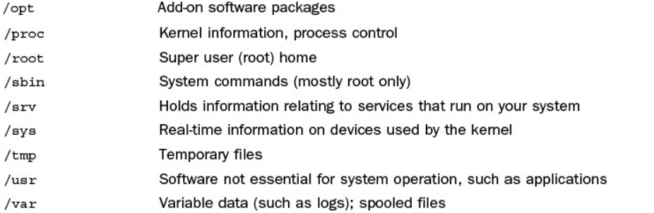
1.5 An Overview of Top Level Directories (Contd.)
The table summarizes few more top level hierarchies in Linux.
Name Description
Notes:
Notes to the Facilitator:
Explain about different directories in Linux.
Notes to the Participants:
/opt/ - Directory where optional software can be installed
/proc/ - Directory where information about processes is stored
/sbin/ - Contains essential system binaries (=tools) used by administrative users
/srv/ - Directory to place data to be served by the server
/sys/ - Contains information about the system, such as drivers and kernel features
/tmp/ - Directory intended for temporary files, often cleared on reboot (because it is stored in RAM, instead of on disk)
/usr/ - Contains non-essential files and binaries as read-only user data
/var/ - Contains variable files, such as logs

Slide 11
1.5.1 /root Directory
/root Directory
Root directory is the top level directory in Linux
/root contains configuration files of root user
Directories installed in the root directory, typically include /boot, /dev, /bin, /etc,/lib, /usr, /var, etc.
Name of directories in the root directory is preceded with a forward slash
Notes:
Notes to the Facilitator:
Explain about root directory.
Notes to the Participants:
The root directory (/) contains below system directories:
/bin - UNIX command directory
/dev - device special directory
/etc - additional program and data file directory
/lib - C programming library directory
/mnt - mount directory—reserved for mounted filesystems
/opt - location of shared software storage object files
/shlib - shared libraries
/stand - filesystem containing the kernel and boot files
/tcb - TCB (Trusted Computing Base) security binaries and databases
/tmp - temporary directory (reserved for temporary files created by programs)
/usr - user service routines—may contain user home directories
/var - location of non-shared software storage object files

Slide 12
1.5.2 /usr Directory
Most of the softwares are installed in /usr directory
/usr contains sub directories such as /bin, /sbin, /lib, /include, etc.
bin
ccs
include
Ibin
lib
Ipp
sbin
share
/usr
adm
/var/adm
spool
/var/spool
tmp
/var/tmp
man
/usr/share/man
Ipd
/usr/lib/Ipd
…
…
Notes:
Notes to the Facilitator:
Explain about /usr directory.
Notes to the Participants:
The /usr directory contain additional UNIX commands and data files stored in separate sub directories. It is the default location of user home directories.
The /usr/bin directory contains UNIX commands which are used less frequently and considered nonessential to UNIX system operation.
The /usr/include directory contains files required for compiling C programs.
The /usr/lib directory contains data files and libraries which are used by various UNIX commands.
The /usr/spool directory contains directories for storing files to be mailed, printed, or passed through networks.
The /usr/tmp directory contains temporary files.
The /usr/adm directory contains data files associated with system administration and accounting.

Slide 13
1.6 Essential Commands in /bin and /sbin
Following are the essential commands in /bin and /sbin:
/bin directory is the primary folder for storing executable programs.
/bin directory contains essential executable files which are required in a single user mode.
The commands in /bin and /sbin need not to be updated often. It is kept stable to maintain system integrity.
/sbin directory holds commands that are required to boot the system.
Root user uses commands in /sbin directory.
Notes:
Notes to the Facilitator:
Discuss about different commands in /bin and /sbin.
Notes to the Participants:
In general, only the root operator uses the commands in the /sbin directory. Often, the commands in these two directories are statically linked, which means that the commands do not depend on software libraries residing under the /lib or /usr/lib directories.
For security reasons, these commands are isolated and kept in a separate location where changes are more difficult and where it will be more obvious for the system administrator if unauthorized changes are made.
If the user wants to create custom scripts and make those scripts available to all users, it can be added /usr/local/bin directory.

Slide 14
What did You Grasp?
System configuration files are stored in which directory?
/root
/bin
/etc
/usr
Kernel modules are stored in which directory?
/root
/usr
/etc
/lib
Notes:
Notes to the Facilitator:
Tell the participants that they will be going through a knowledge check question.
Answer:
1. c. /etc
2. d. /lib

Slide 15
What did You Grasp?
The XFS File system has advanced features like ______.
Copy on Write
Parallel I/O
I/O compression
Auto disk crash recovery
Which directory holds the commands needed to boot the system?
/bin
/sbin
/root
/usr
Notes:
Notes to the Facilitator:
Tell the participants that they will be going through a knowledge check question.
Answer:
3. b. Parallel I/O
4. b. /sbin

Slide 16
2.1 Permissions in Linux
It’s a mechanism to support OS system files/directories.
Protection ensures that users will not misuse the resources.
Resources include CPU, memory, network, partitions, directories, etc.
Permissions will protect the file system so that a user cannot misuse files owned by other user.
There are three levels of permission in Linux:
Owner
Rest of the world
Group
Notes:
Notes to the Facilitator:
Explain permissions in Linux.
Notes to the Participants:
In Linux, permissions are controlled at three levels:
Owner (called user, or ‘u’ for short)
Group (‘g’ for short)
The rest of the world (called other, or ‘o’ for short)
The following list describes what each level of access provides:
Read—for a file, it can be viewed or copied
Write—for a file, it can be overwritten (e.g., using save as)
Execute—for a file, it can be executed (this is necessary for executable programs and shell scripts)
Read—for a directory, the directory’s contents can be viewed by ls
Write—for a directory, files can be written there
Execute—for a directory, a user can do cd into it

Slide 17
2.1 Permissions in Linux (Contd.)
The image shows the different levels of permissions in Linux.
- rwx r-x --x
File type (- means regular file)
U permissions
g permissions
o permissions
Notes:
Notes to the Facilitator:
Explain permissions in Linux.
Notes to the Participants:
Permission Explanation
000 No one has any type of access to the item
200 Write only
400 Read only for owner
644 Access to owner, read-only for all others
664 Access to owner and group, read-only for world
660 Access to owner and group, no access for world
646 World can write but group members cannot
755 Adding execute access to 644, used for directories, script files, and executable programs
745 Execute privilege added to owner and world
775 Adds write access to group
711 Group members and world can execute the file only
666/777 Read and write access to everyone

Slide 18
What did You Grasp?
/dev partition stores _______.
Developer code
Device files
Partition data
MBR
Access privilege 400 indicates _________.
Read only for owner
Write only
Read for everyone
No one has access
Notes:
Notes to the Facilitator:
Tell the participants that they will be going through a knowledge check question.
Answer:
1. b. Device files
2. a. Read only for owner

Slide 19
What did You Grasp?
/sys directory holds ______ data.
Real-time information
System information
Error logs
Boot files
Access privilege 200 indicates _________.
Read only for owner
Write only
Read for everyone
No one has access
Notes:
Notes to the Facilitator:
Tell the participants that they will be going through a knowledge check question.
Answer:
3. a. Real-Time information
4. b. Write only

Slide 20
3.1 GRUB
GRUB stands for Grand Unified Bootloader
GRUB is the software that loads Linux Kernel
GRUB is used to boot Linux distributions
GRUB uses /boot/grub/grub.conf file to boot the system
Dual boot can be configured using GRUB
Power-up / Reset
System startup
BIOS/BootMonitor
Stage 1 bootloader
Master Boot Record
Stage 2 bootloader
LILO, GRUB, etc.
Kemel
Linux
Init
User-space
Operation
Notes:
Notes to the Facilitator:
Give the participants an overview of GRUB.
Notes to the Participants:
When the computer starts, BIOS first run POST (Power-on self-test) to check memory, disk drives and find if it is working properly.
Then the BIOS checks the MBR (Master Boot Record), which is a 512 byte section located first on the Hard Drive. It looks for a bootloader like GRUB.
Then you'll be prompted to select the OS by the GRUB menu which contains the list of OS installed.
When you select the OS or kernel, GRUB loads the selected kernel. The kernel starts system (or init) which is the first process in Linux that will be started. init then starts other processes that are configured to start at the boot time.

Slide 21
3.2 MBR
MBR stands for Master Boot record
If the server hardware is working properly, BIOS will handover control to the first boot device
MBR is a small program that is executed while a system is booting
MBR is created when disk partition is created
MBR is located in the first disk sector
Notes:
Notes to the Facilitator:
Explain about MBR.
Notes to the Participants:
When booting from the hard disk, the BIOS first loads the contents of the MBR in the memory and allows it to take control. This code then loads the OS from a bootable partition, which then loads the operating system.
Boot sector used by partition table consumed 64 bytes.
If the MBR is broken, the system will fail to boot and display following errors:
1."Error loading operating system 2."Operating System missing" or "Operating System not found" 3."Invalid partition table_" 4."Reboot and Select proper Boot device or Insert Boot Media in selected Boot device and press a key_"

Slide 22
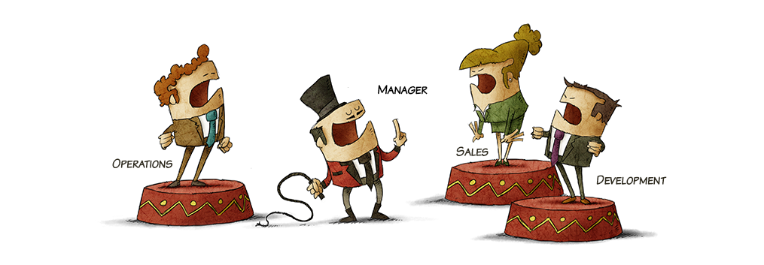
Group Discussion
Notes:
Notes to facilitator:
Form different groups of students. Each group should talk about one of the Linux file system hierarchy, why it is unique, structure of file system hierarchy, overview of Linux directories and GRUB.
Notes to participants:
We’ve so far seen about the important concepts associated with file systems. Form different groups and each group should talk about one concept in detail along with analogies or examples to show your understanding.

Slide 23
What did You Grasp?
GRUB configuration file is located in which location?
/grub/grub.conf
/usr/grub/grub.conf
/root/grub.conf
/boot/grub/grub.conf
Dual boot can be configured using ______.
MBR
GRUB
BIOS
Partition table
Notes:
Notes to the Facilitator:
Tell the participants that they will be going through a knowledge check question.
Answer:
1. d. /boot/grub/grub.conf
2. b. GRUB

Slide 24
What did You Grasp?
Boot sector used by partition table consumes _____ bytes.
64 bytes
128 bytes
256 bytes
512 bytes
MBR is located in ________.
First disk sector
Last disk sector
/root directory
/usr directory
Notes:
Notes to the Facilitator:
Tell the participants that they will be going through a knowledge check question.
Answer:
3. a. 64 bytes
4. a. First disk sector

Slide 25
In a nutshell, we learnt:
Linux File system defines the way the data is stored and retrieved from the medium
Linux and other Unix like systems use tree structure
Linux File system is adhered to the FHS (Filesystem Hierarchy Standard)
In Linux everything is considered as a file
It is referred to as a tree because it starts at a single origin point, the root (found at /)
Permissions will protect the file system so that a user can not misuse files owned by other user
When the computer starts, BIOS first run POST (Power-on self-test) to check memory, disk drives and find if it is working properly
Notes:
Notes to the Facilitator:
Share the module summary with the audience.
Ask the participants if they have any questions. They can ask their queries by raising their hands.
Notes to the Participants:
Now, you have reached the end of the module, In this module, you have learned:
Linux File system defines the way the data is stored and retrieved from the medium
Linux and other Unix like systems use tree structure
Linux File system is adhered to the FHS (Filesystem Hierarchy Standard)
In Linux everything is considered as a file
It is referred to as a tree because it starts at a single origin point, the root (found at /)
Permissions will protect the file system so that a user can not misuse file’s owner by other user
When the computer starts, BIOS first run POST (Power-on self-test) to check memory, disk drives and find if it is working properly

Slide 26
Next Module 3: Package Management Systems

